Slide 1
How to Get a 16 Year Old a Job
Roger Shelley
Volume 1

Slide 2
Why Work?

Slide 3
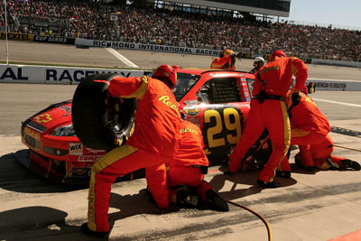
What Do You Want to Do?

Slide 4
How Do We Start?

Slide 5
Expect Employment First
Have a job before leaving school
How?
Youth employment services/9 Star
IEP Goal
Career Development Activities

Slide 6
Expect Employment First
Employment Service Providers (Waiver)
MSCA
HOPE
Bright Horizons
Prevocational waiver services/ job development

Slide 7
Expect Customized Employment to Offer
Job opportunities matched to your son or daughter’s interests or skills
Job opportunities in real world situations
A variety of possibilities

Slide 8
And There’s Always Self-Employment!
More $
More Accommodations
More Supports
Opportunities to Save $

Slide 9
Student Earned Income Exclusion
Provision allowing person under age 22 and regularly attending school to exclude earnings from income
In January 2013 the amounts increased to $1,730 monthly, up to a yearly maximum of $6,960

Slide 10
Example
Jim is a student who earns $1,800 a month in June, July and August of 2013. In September he returns to school and continues working part-time, earning $900 per month through December.
Using the student earned income exclusion, Jim can exclude $1,730 of his earnings in June, July and August, and can exclude all of his $900 earnings in September. Excluding $870 from his October earnings will use up his yearly limit. After deducting monthly and yearly limits, his remaining income will still be subject to the earned income exclusion of $65 per month and one-half of the remaining earned income.

Slide 11
What are your concerns?
?
?
?

